Slide 1
IBM Applied Data Science Capstone
Opening a New Chinese Restaurant in NYC, USA
Yiming Du
July 2021

Slide 2
1 Introduction
Business Problem
Data and Methodology
Exploratory Data Analysis
Discussion
Conclusion

Slide 3

1. Introduction
New York City is the largest city and largest port in the United States. As of 2017, New York City has a total area of 1214.4 square kilometers and a population of approximately 8.62 million. The food culture of New York is influenced by many immigrants, so it is very diverse. New York City is also a gathering place for fine restaurants. Common exotic foods in New York City include Italian, French, Spanish, Russian, British, Greek, Moroccan, Chinese, Brazilian, and Japanese dishes.
Image source:www.baidu.com

Slide 4

2. Business Problem
This project finally explored the best locations for Chinese restaurants throughout New York City. New York is a cosmopolitan city, where people of all nationalities blend together, so it has a long tradition of restaurants of different nationalities. In recent decades, there have been a lot of Chinese tourists and immigrants in New York, so Chinese restaurants are very popular. Everyone understands that the location of a restaurant is one of the most important factors affecting the success or failure of a restaurant. So if I want to open a new Chinese restaurant in New York, what factors do I need to consider?
Image source:www.baidu.com

Slide 5
3. Data and Methodology
we need data on New York City’s neighborhoods and administrative districts , including boundaries, latitude, longitude, restaurants, and restaurant ratings and tips. New York City data including neighborhoods and administrative districts, latitude and longitude will be obtained from the data source: https://cocl.us/new_york_dataset. All data related to the location and quality of Chinese restaurants will be obtained through the FourSquare API used by the request library in Python.
Data will be collected from https://cocl.us/new_york_dataset and cleaned and processed into a dataframe. FourSquare be used to locate all venues and then filtered by Chinese restaurants. Ratings, tips, and likes by users will be counted and added to the dataframe. Data will be sorted based on “Likes”. Finally, the data will be visually assessed using graphing from Python libraries.

Slide 6
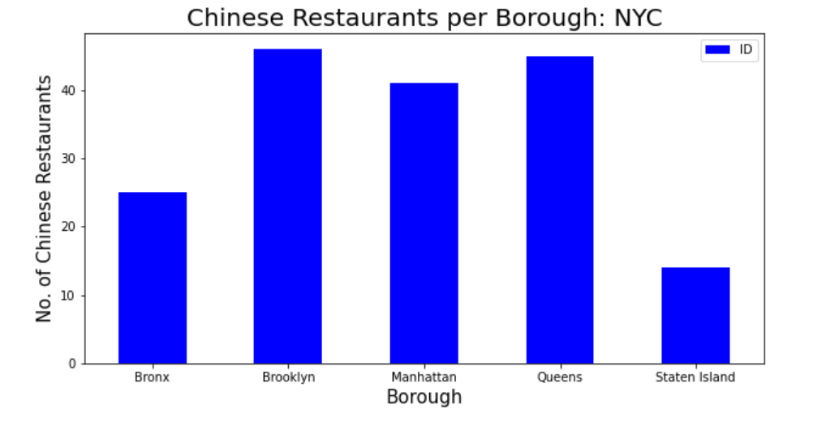
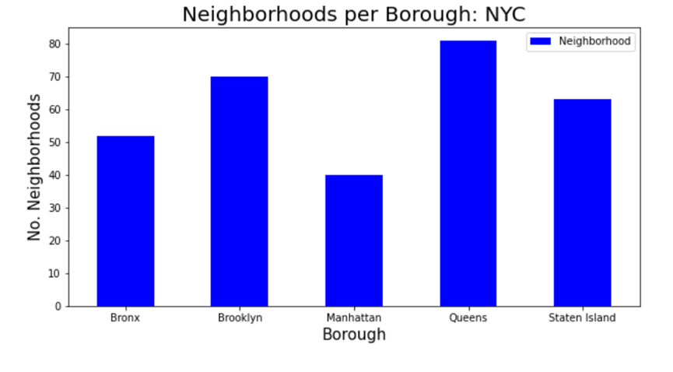
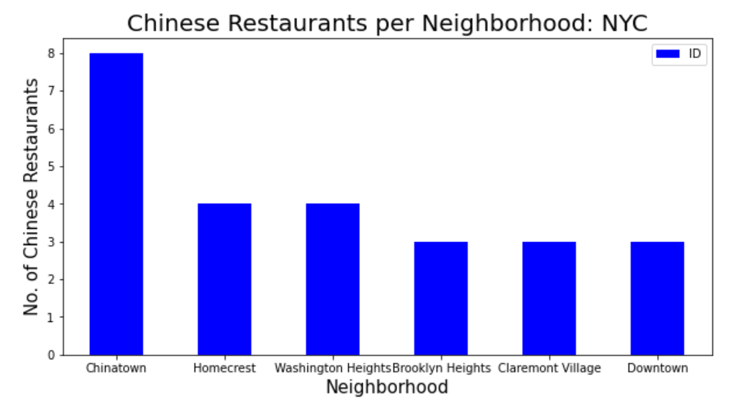
4. Exploratory Data Analysis
Relationship between Borough/ Neighborhoods
and Chinese restaurants
Relationship between Neighborhoods and Borough

Slide 7
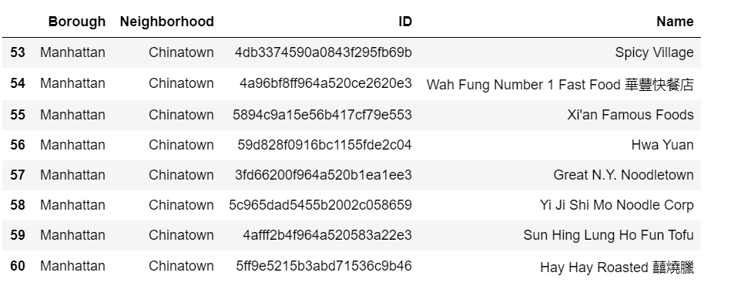
4. Exploratory Data Analysis
After data cleaning and analysis, we found that there are 171 Chinese restaurants in New York. The specific code and process can be seen in the notebook. From the following two charts, we can find some interesting phenomena. From a borough perspective, as we can see below, although Manhattan has the least number of neighborhoods (Neighborhoods per Borough: NYC), it has many Chinese restaurants. Brooklyn has the most Chinese restaurants, followed by Queens. From the “Chinese Restaurants per Neighborhood” chart, it can be seen that Chinatown has the most Chinese restaurants, and Chinatown is located in Manhattan.
Figure . Chinese Restaurants in Chinatown

Slide 8
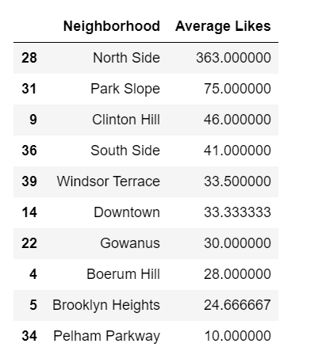
4. Exploratory Data Analysis
We analyzed the top 10 neighborhoods with the highest average preference of Chinese restaurants .From the chart, we can see that the average restaurant preferences vary greatly. The maximum value is 363 and the minimum value is only 10. In order to facilitate subsequent analysis, we use Average Likes=30.0 as the cut-off point to select the most suitable location for Chinese restaurants.
Then we need to analyze average likes of Chinese Restaurants for each Borough. Through analysis, we have concluded that Chinese restaurants in Brooklyn are the most popular on average. Then, we will consider all the neighborhoods with average likes greater or equal 30.0 to visualize on a map.

Slide 9
5. Discussion
All the project analysis depends on the accuracy of Four Square data. More comprehensive analysis and future work need to incorporate data from other external databases.
Through our various analyses above, we can draw conclusions. Among the Chinese restaurants in New York, Chinese restaurants in Manhattan and Brooklyn are highly liked on average. At the same time, we got 171 Chinese Restaurants across New York City. From a borough perspective, although Manhattan has the least number of neighborhoods(Neighborhoods per Borough: NYC), it has a lot of Chinese restaurants. Brooklyn has the most Chinese restaurants, followed by Queens. From the “Chinese Restaurants per Neighborhood” chart, we can see that Chinatown has the most Chinese restaurants, and Chinatown is located in Manhattan.

Slide 10
6. Conclusion
I will open a Chinese restaurant in Brooklyn.
Advantage
1. Brooklyn has multiple neighborhoods, and the average customer “likes” rate exceeds 30.
2. The concentration of Chinese restaurants is less than that of Manhattan's Chinatown. Therefore, opening a Chinese restaurant in Brooklyn is less competitive than opening a Chinese restaurant in Chinatown.
3. Real estate prices in Brooklyn are much cheaper than in Manhattan, so the rent and cost of opening a restaurant will be lower than in Chinatown in Manhattan.
4. Brooklyn is the most populous borough on the western end of Long Island. The culture, society and race of this area are very diverse.

Slide 11

Thank you for watching

